Slide 1


DESIGN 1
Lesson 4: Peer Review & Structure Check
Ms. Abboud · Grade 9 - Design 1 · Term 1, Week 2

Slide 2
Learning Objectives
WALT - We Are Learning To
WILF - What I'm Looking For
Review and correct HTML document structure errors through peer feedback.
Complete this week's formal structure check against the success criteria.
Create a valid HTML document structure.
Use tags correctly and display content successfully in a browser.

Slide 3
Frayer Model: Doctype Declaration (Review)
DEFINITION
CHARACTERISTICS
The very first line of an HTML file (<!DOCTYPE html>) that tells the browser which version of HTML to expect.
Always the very first line; tells the browser the HTML version; no closing tag.
DOCTYPE DECLARATION (REVIEW)
EXAMPLES
NON-EXAMPLES
<!DOCTYPE html>
<html>; a comment in the code.

Slide 4
National Identity Integration
UAE Digital Economy: every clearly structured webpage you build is a small-scale example of the digital infrastructure the UAE is investing in as it grows a knowledge-based economy. The same logical organization you practice today, breaking a page into head and body, nesting elements correctly, is exactly what powers the government services, banking apps, and businesses that make up the UAE's digital economy.

Slide 5
STARTER
Quick-fire: spot the errors
Look at this snippet on the board. Call out what's broken.
Hook · Engage & Ask
5 - 10 minutes
Example: find the 3 mistakes
<html>
<hed>
<title>Oops</title>
<hed>
<body>
<h1>Missing DOCTYPE
</body>
</html>

Slide 6
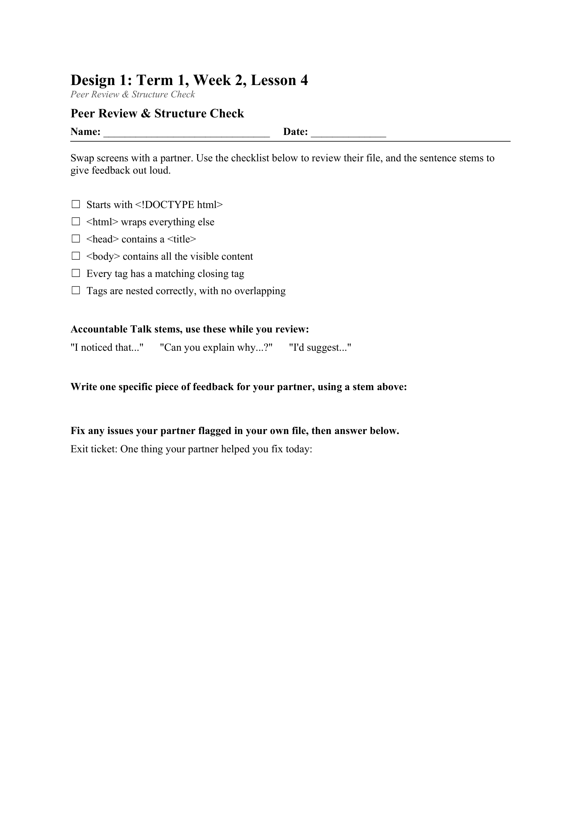
LESSON CORE
We Do: Peer Review
Swap laptops or screens with a partner and use the checklist to review each other's file.
Use Accountable Talk stems while you review: 'I noticed that...', 'Can you explain why...?', 'I'd suggest...'
Activity: Peer Review & Structure Check
Gradual Release of Responsibility
30 - 40 minutes
1 / 2

Slide 7
LESSON CORE
We Do: Fix & Check
Whole-class troubleshooting of the 2-3 most common recurring errors seen during peer review.
Fix any issues your partner flagged, then submit your file for the formal structure check.
Gradual Release of Responsibility
30 - 40 minutes
2 / 2

Slide 8
CLOSURE
Exit ticket
One thing your partner helped you fix today.
Next week: Headings, Paragraphs & Text Formatting.
Transition & Extend
5 - 10 minutes

